Slide 1
Supervised Learning
Abdul Samad
Adopted from Prof. Simon Prince

Slide 2
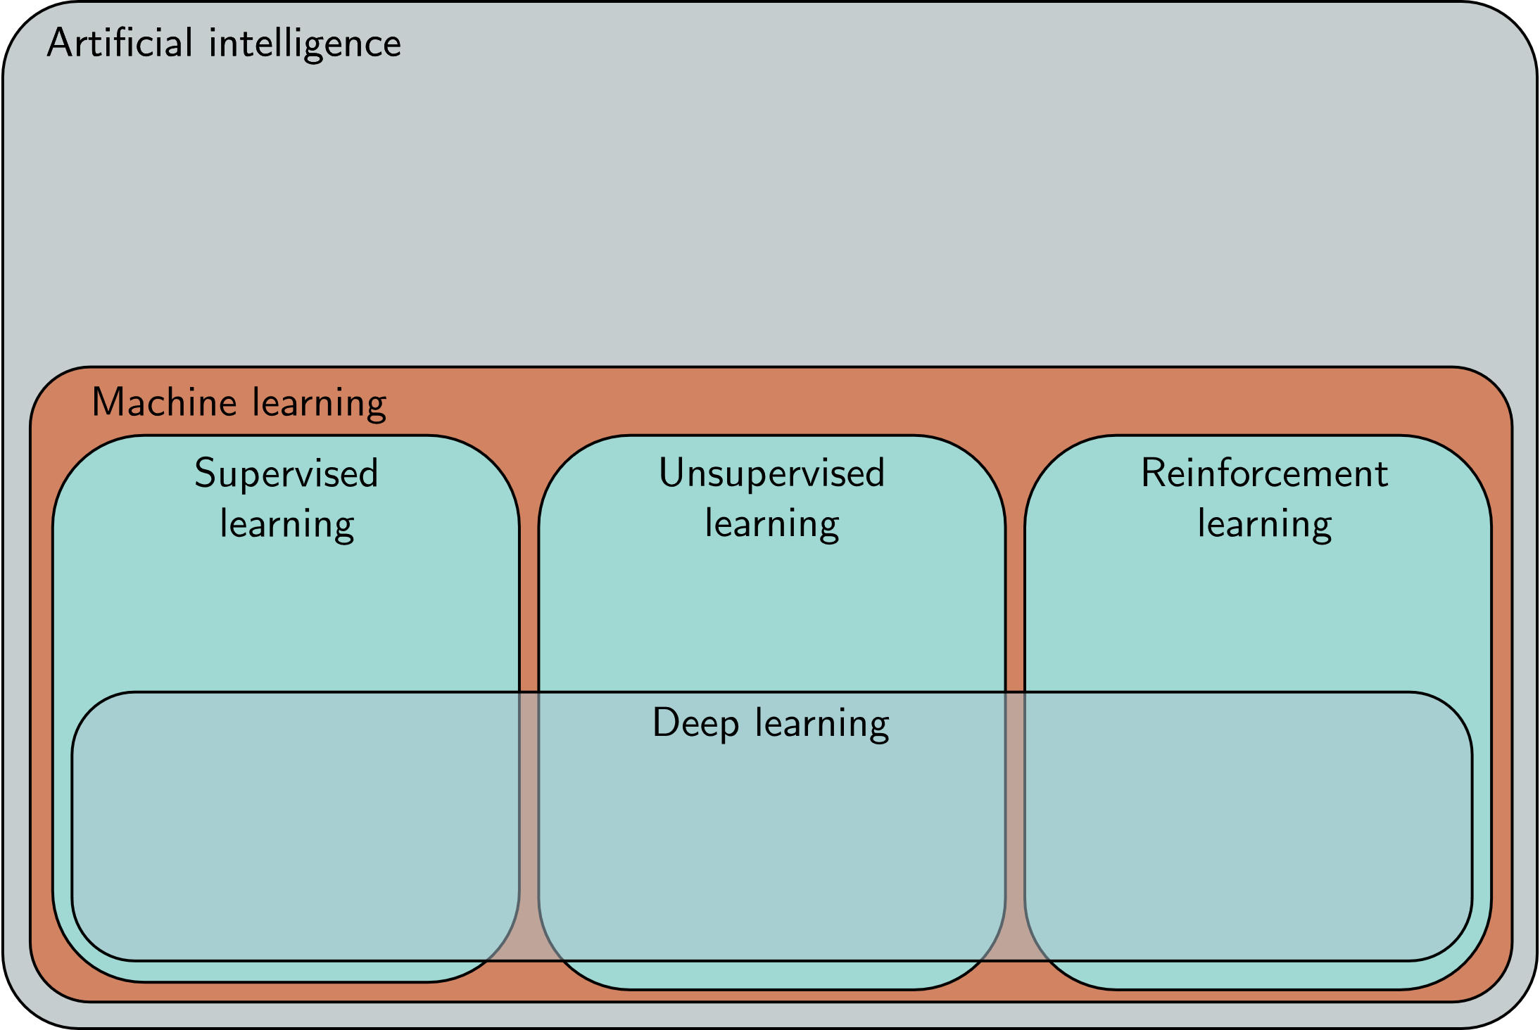

Slide 3
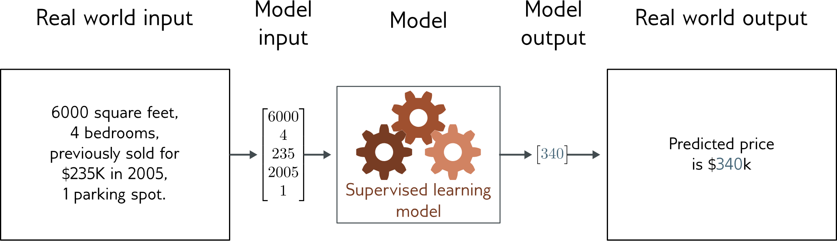
Regression
Univariate regression problem (one output, real value)

Slide 4
Supervised learning
Overview
Notation
Model
Loss function
Training
Testing
1D Linear regression example
Model
Loss function
Training
Testing
Where are we going?

Slide 5
Supervised learning
Overview
Notation
Model
Loss function
Training
Testing
1D Linear regression example
Model
Loss function
Training
Testing
Where are we going?

Slide 6
Supervised learning overview
Supervised learning model = mapping from one or more inputs to one or more outputs
Model is a mathematical equation
Computing the inputs from the outputs = inference

Slide 7
Supervised learning overview
Supervised learning model = mapping from one or more inputs to one or more outputs
Model is a mathematical equation
Computing the inputs from the outputs = inference
Example:
Input is age and milage of secondhand Toyota Prius
Output is estimated price of car

Slide 8
Supervised learning overview
Supervised learning model = mapping from one or more inputs to one or more outputs
Model is a mathematical equation
Computing the inputs from the outputs = inference

Slide 9
Supervised learning overview
Supervised learning model = mapping from one or more inputs to one or more outputs
Model is a mathematical equation
Computing the inputs from the outputs = inference
Model also includes parameters
Parameters affect outcome of equation

Slide 10
Supervised learning overview
Supervised learning model = mapping from one or more inputs to one or more outputs
Model is a mathematical equation
Model is a family of equations
Computing the inputs from the outputs = inference
Model also includes parameters
Parameters affect outcome of equation

Slide 11
Supervised learning overview
Supervised learning model = mapping from one or more inputs to one or more outputs
Model is a mathematical equation
Model is a family of equations
Computing the inputs from the outputs = inference
Model also includes parameters
Parameters affect outcome of equation

Slide 12
Supervised learning overview
Supervised learning model = mapping from one or more inputs to one or more outputs
Model is a family of equations
blank
Computing the inputs from the outputs = inference
Model also includes parameters
Parameters affect outcome of equation

Slide 13
Supervised learning overview
Supervised learning model = mapping from one or more inputs to one or more outputs
Model is a family of equations
Blank
Computing the inputs from the outputs = inference
Model also includes parameters
Parameters affect outcome of equation
Training a model = finding parameters that predict outputs “well” from inputs for a training dataset of input/output pairs

Slide 14
Supervised learning
Overview
Notation
Model
Loss function
Training
Testing
1D Linear regression example
Model
Loss function
Training
Testing
Where are we going?

Slide 15
Notation:
Input:
Output:
Model:
Variables always Roman letters
Normal = scalar
Bold = vector
Capital Bold = matrix
Functions always square brackets
Normal = returns scalar
Bold = returns vector
Capital Bold = returns matrix

Slide 16
Notation example:
Input:
Output:
Model:
Structured or tabular data

Slide 17
Model
Parameters:
Model :
Parameters always Greek letters

Slide 18
Loss function
Training dataset of I pairs of input/output examples:
Loss function or cost function measures how bad model is:
or for short:
Notes:
\begingroup\color{marginColor}
{\color{black}L\Bigl[\bfphi, }\underbrace{\color{black}\mystrut{2.0ex}\mbox{f}[\bfx,\bfphi]}_{\mbox{model}}, \underbrace{\color{black}\mystrut{2.0ex}\{\bfx_{i},\bfy_{i}\}}_{\mbox{data}}\Bigr]
\endgroup

Slide 19
Loss function
Training dataset of I pairs of input/output examples:
Loss function or cost function measures how bad model is:
or for short:
Returns a scalar that is smaller when model maps inputs to outputs better
Notes:
\begingroup\color{marginColor}
{\color{black}L\Bigl[\bfphi, }\underbrace{\color{black}\mystrut{2.0ex}\mbox{f}[\bfx,\bfphi]}_{\mbox{model}}, \underbrace{\color{black}\mystrut{2.0ex}\{\bfx_{i},\bfy_{i}\}_{i=1}^{I}}_{\mbox{train data}}\Bigr]
\endgroup

Slide 20
Training
Loss function:
Find the parameters that minimize the loss:
Returns a scalar that is smaller when model maps inputs to outputs better

Slide 21
Testing
To test the model, run on a separate test dataset of input / output pairs
See how well it generalizes to new data

Slide 22
Supervised learning
Overview
Notation
Model
Loss function
Training
Testing
1D Linear regression example
Model
Loss function
Training
Testing
Where are we going?

Slide 23
Example: 1D Linear regression model
Model:
Parameters
y-offset
slope

Slide 24
Example: 1D Linear regression model
Model:
Parameters
y-offset
slope

Slide 25
Example: 1D Linear regression model
Model:
Parameters
y-offset
slope

Slide 26
Example: 1D Linear regression model
Model:
Parameters
y-offset
slope

Slide 27
Example: 1D Linear regression training data

Slide 28
Example: 1D Linear regression training data
Loss function:
“Least squares loss function”

Slide 29
Example: 1D Linear regression loss function
Loss function:
“Least squares loss function”

Slide 30
Example: 1D Linear regression loss function
Loss function:
“Least squares loss function”

Slide 31
Example: 1D Linear regression loss function
Loss function:
“Least squares loss function”

Slide 32
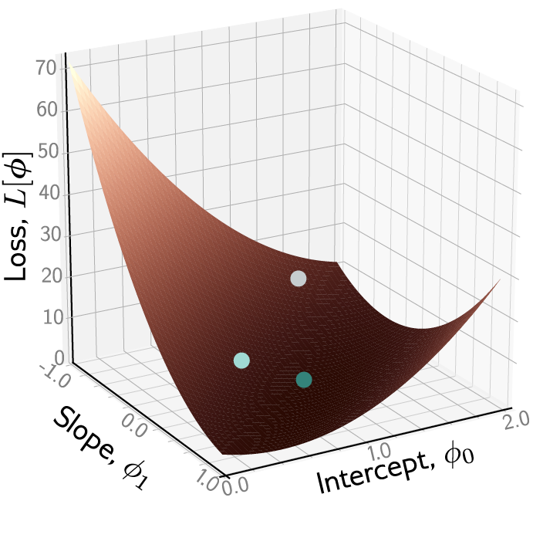
Example: 1D Linear regression loss function
Loss function:
“Least squares loss function”

Slide 33
Example: 1D Linear regression loss function

Slide 34
Example: 1D Linear regression loss function

Slide 35
Example: 1D Linear regression loss function

Slide 36
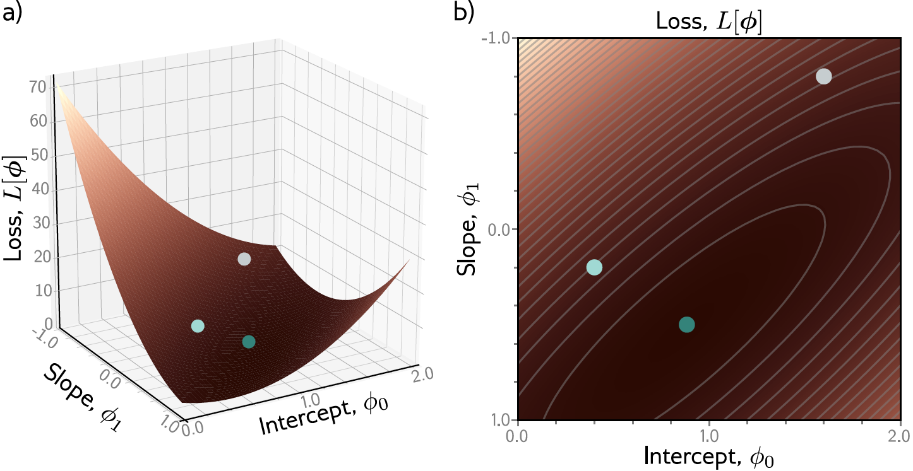
Example: 1D Linear regression loss function

Slide 37
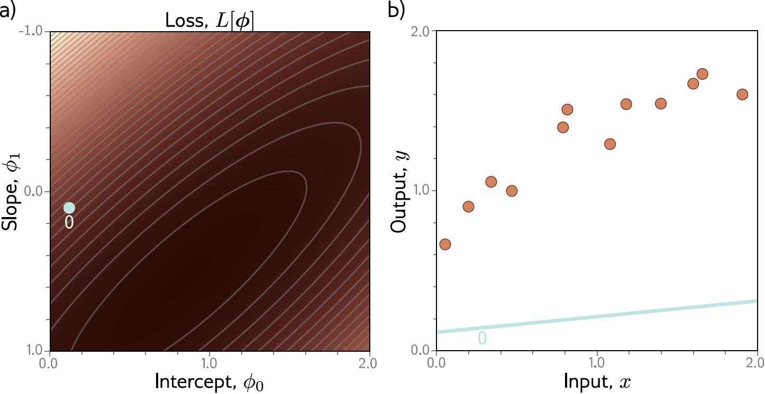
Example: 1D Linear regression training

Slide 38
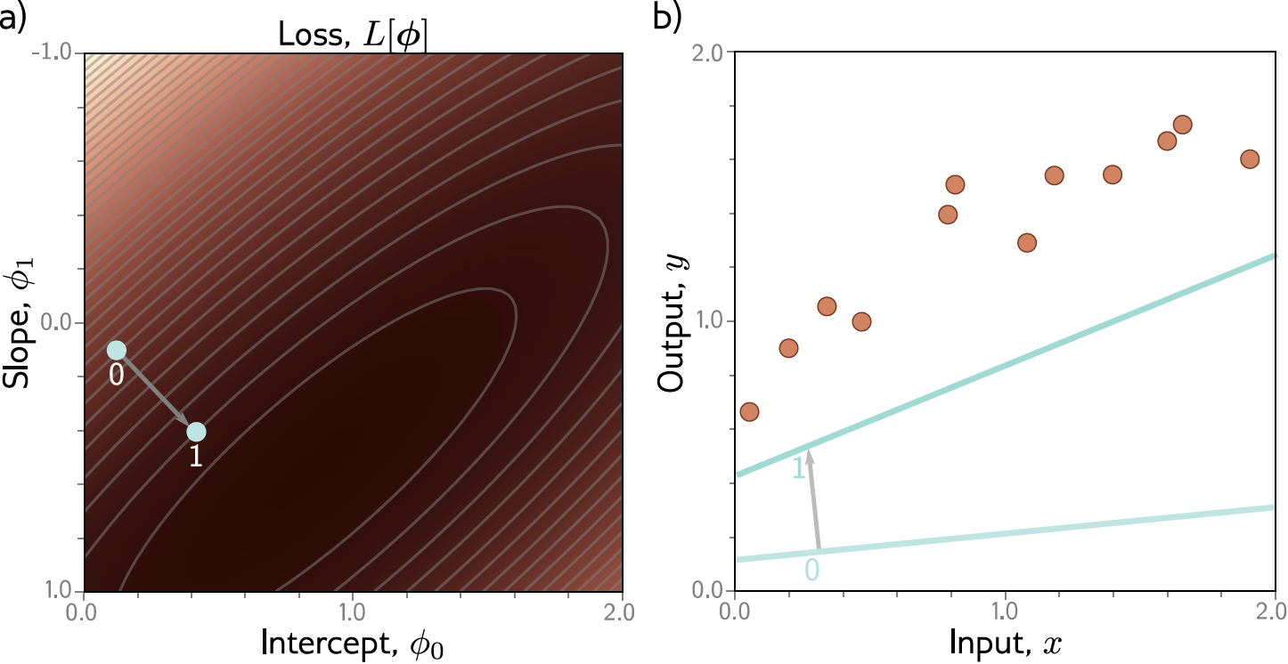
Example: 1D Linear regression training

Slide 39
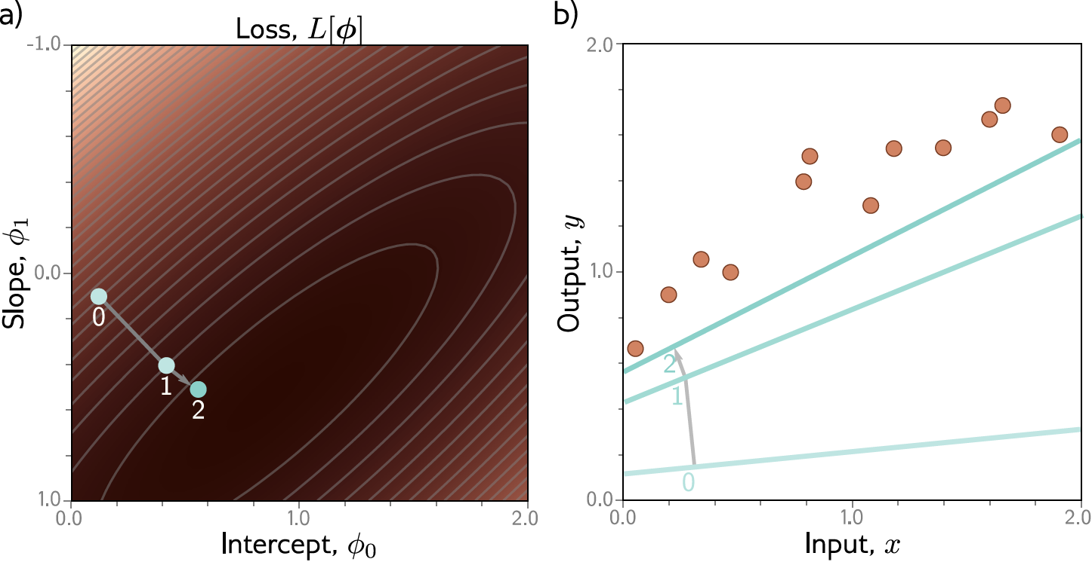
Example: 1D Linear regression training

Slide 40

Example: 1D Linear regression training

Slide 41
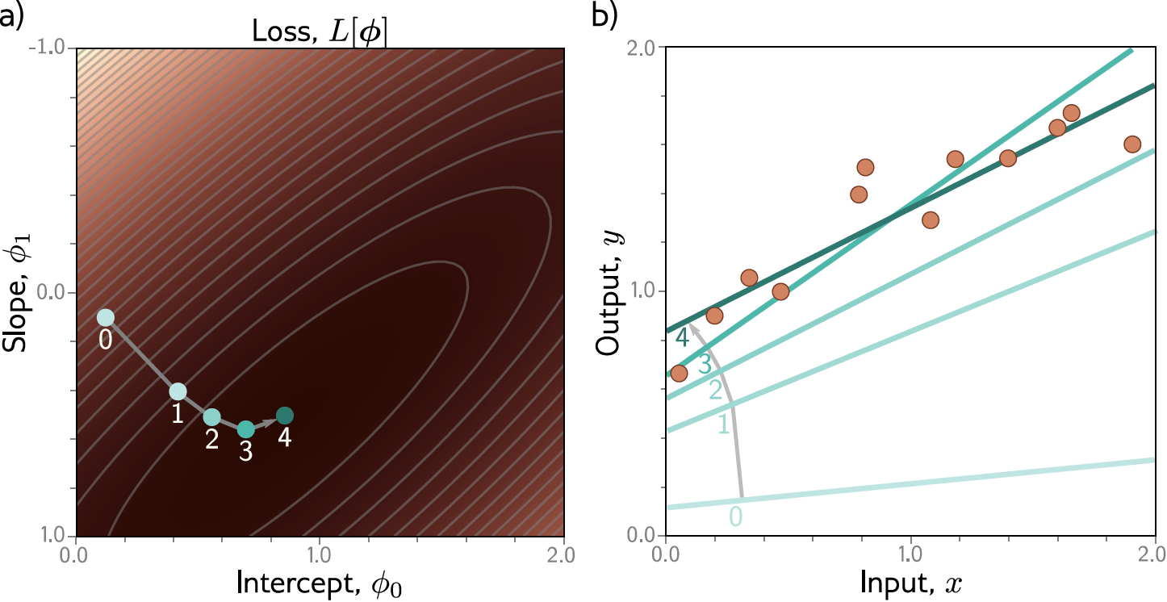
Example: 1D Linear regression training
This technique is known as gradient descent

Slide 42
Example: 1D Linear regression testing
Test with different set of paired input/output data
Measure performance
Degree to which this is same as training = generalization
Might not generalize well because
Model too simple
Model too complex
fits to statistical peculiarities of data
this is known as overfitting

Slide 43
Supervised learning
Overview
Notation
Model
Loss function
Training
Testing
1D Linear regression example
Model
Loss function
Training
Testing
Where are we going?

Slide 44
Where are we going?
Shallow neural networks (a more flexible model)
Deep neural networks (an even more flexible model)
Loss functions (where did least squares come from?)
How to train neural networks (gradient descent and variants)
How to measure performance of neural networks (generalization)

